Slide 1
MST30819 Certificate III
Applied Fashion Design
and Technology
Notes:
Certificate III in Applied Fashion Design and Technology covers a variety of creative and technical skills. No previous experience is required.

Slide 2
Course Information
Fibres & Fabric
Fabric types
Plus
Embellishment
Sustainability
Fabric characteristics
Fabric properties
Work Safely
Quality standards
ICT skills
Research & Trends
Inspiration
Design Sketching
Elements & Principles
Storyboard
Design
Pattern Making
Plan
Garment Construction
Industrial & domestic machines
Pressing & finishing
Create pattern
Test Pattern
Machine sample
Industry construction techniques
Industry specifications
Alterations
Notes:
Certificate III is a well rounded qualification with units covering design, patternmaking, garment construction, fibres & fabric, garment embellishment and sustainability. The next few pages will discuss each area in more detail.

Slide 3
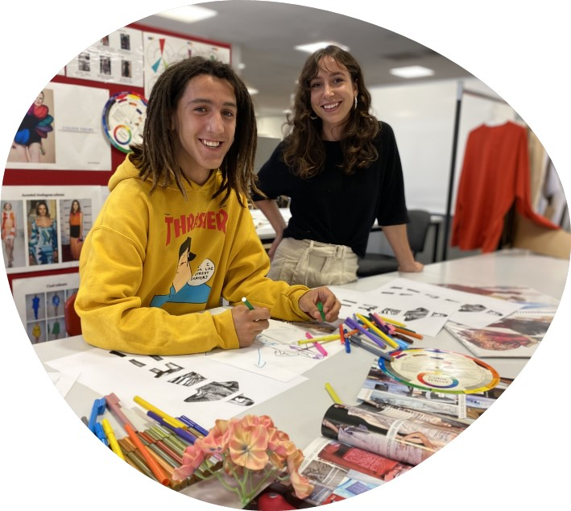
Course Information
Fashion Design
Research trends & history
Create inspiration boards
Elements & principles
Colour Theory
Sketch Designs
Storyboard
Notes:
During the course students are introduced to the design process where they research and investigate fashion trends and past significant events from the 20th Century influencing fashion, create visual inspiration boards and develop design sketches.
Students develop their own design ideas using the elements and principles of design and finally produce a storyboard to illustrate their design concept. During the design process students are introduced to different drawing styles including sketching and trade drawing.

Slide 4
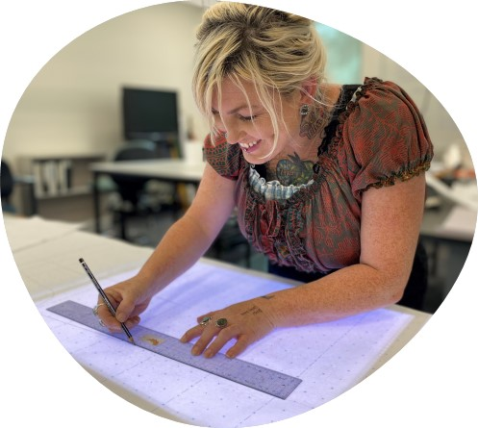
Course Information
Pattern Making
2D into 3D
Design analysis
Plan
Draft pattern
Test pattern
Machine sample
Notes:
Pattern making is an important step in the development of a new design product. Students are introduced to patternmaking principles as they develop pattern drafting skills.
Patternmaking involves design analysis, planning, drafting, testing the pattern for design accuracy and fit by machining a garment sample.
Pattern making is both technical and creative, and is the process where a two dimensional flat design idea is transformed into a three dimensional garment.

Slide 5
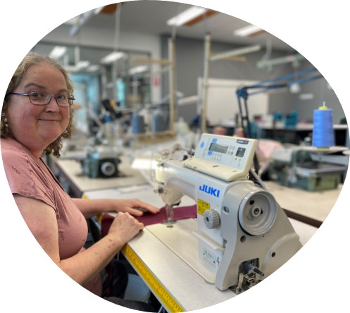
Course Information
Garment Construction
Industrial & domestic machines
Pressing & finishing
Industry construction techniques
Embellishment techniques
Industry specifications
Alterations
Notes:
The machining workroom is home to a suite of industrial sewing machines that students train on to develop skills for garment production. Students learn how to assemble garments including – skirts, pants, tops, shirts and dresses.
Learn how to handle garment components at many different types of industrial sewing machines to create garments to industry standards, in both woven and knitted fabrics.
In addition, students learn how to use industrial and domestic pressing equipment and how to quality check finished garments. Students also learn basic repair and alteration techniques.
https://www.pexels.com/photo/person-holding-red-dress-shirt-on-hanger-2249248/

Slide 6
Course Information
Fibres & Fabrics
Fabric types
Fabric characteristics
Fabric properties
Other Areas of Study
Embellishment
Sustainability
Work Safely
Quality standards
ICT skills
Notes:
Fabric knowledge is a critical part of the fashion design process. Develop knowledge on different fabric types, how fabric is made and why fabrics behave differently from each other. Learn how to test for fibre content and different types of yarns.
Other areas of study within the course include: Embellishing garments; sustainability; work, health and safety, quality and ICT skills.
https://www.pexels.com/photo/crop-master-rolling-up-dyed-fabric-6850494/

Slide 7
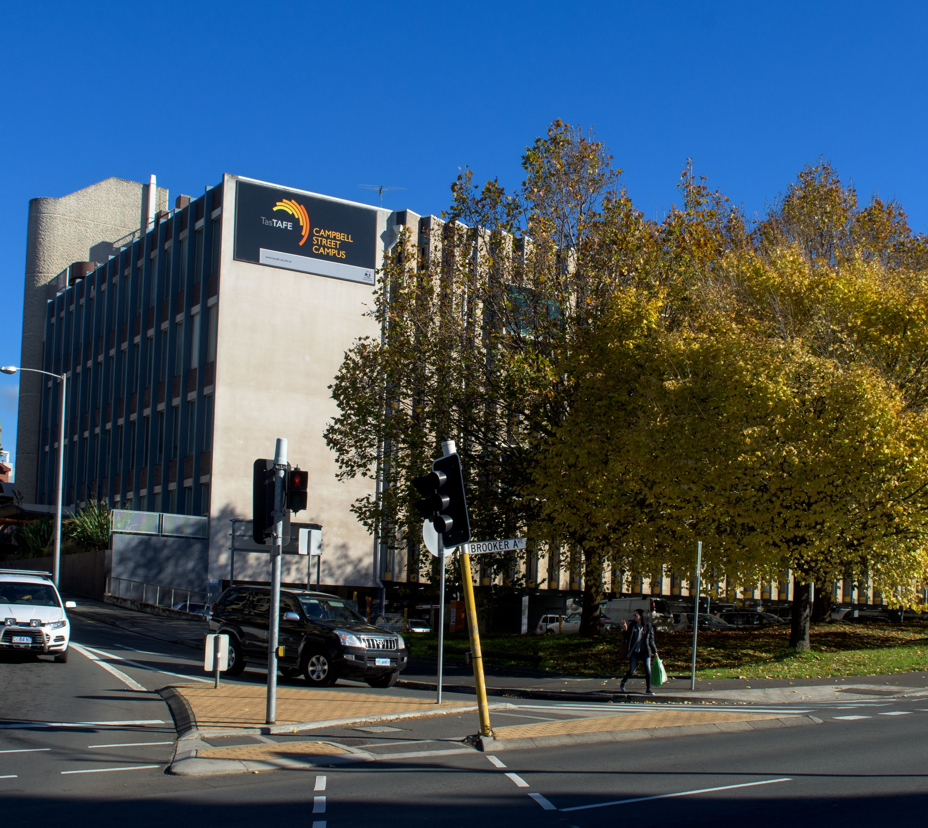
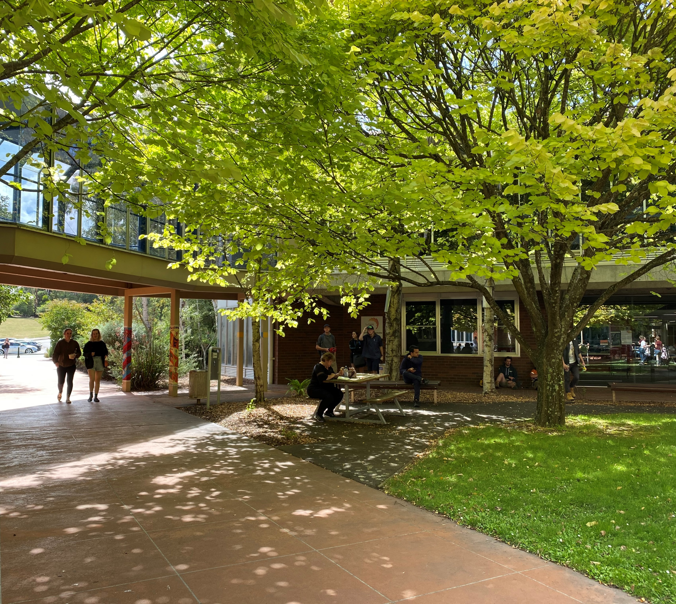
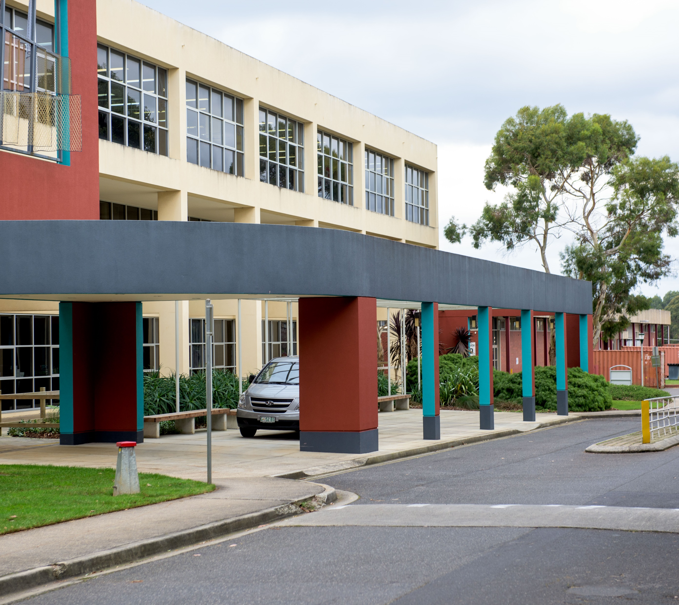
Fashion Campuses
Campbell St, Hobart
Alanvale Rd, Launceston
Mooreville Rd, Burnie
Notes:
The qualification is out in one of our three campuses across the state in well resourced workrooms. There are campus in Hobart, Launceston and Burnie run by friendly qualified staff.

Slide 8
Course Entry Requirements
There are no entry requirements or
pre-requisites for this qualification
Desirable Personal Attributes Include:
Respectful Positive Attitude
Hard Working & Persistent
Enjoy Practical & Technical Work
Enjoy Being Creative & Problem Solving
Have Basic English Language, Reading, Writing & Computer Skills
Notes:
There are no pre-requisite requirements to study this qualification. Anyone can apply, however we do recommend that you have a genuine interest in technical work and enjoy practical creative tasks. You should also be respectful, positive, hardworking and persistent. Students also need to be prepared to complete some theory, paperwork and have a commitment towards quality. Basic English language, reading, writing & computer skills will help you to succeed in the course. If you need assistance in any of these areas please contact staff or student support services to discuss your needs.

Slide 9
MST30819 Units of study
This course has a total of nineteen (19) units consisting of:
Four (4) Core units and fifteen (15) Elective units
Core unit list
MSMENV272 Participate in environmentally sustainable work practices
MSMWHS200 Work safely
MSS402051 Apply quality standards
MSTGN2013 Identify fibres, fabrics and textiles used in the TCF industry
Notes:
Students need to complete 19 units of study to achieve a Certificate III. Students who choose to enrol must complete all units to gain a qualification.
The core units listed on this slide cover WH&S, sustainability, quality standards and fibres and fabric identification. The next two slides will display the set elective units.

Slide 10
Units of Study – MST30819
Elective unit list
MSTCL2007 Lay-up, mark and cut uncomplicated fabrics and lays
MSTCL2010 Modify patterns to create basic styles
MSTCL2011 Draw and interpret a basic sketch
MSTCL3002 Prepare and produce a complex whole garment from specifications
MSTCL3007 Embellish garment by hand or machine
MSTCL3009 Develop patterns from a block using basic patternmaking principles
MSTCL3010 Sew woven and stretch knit garments
Notes:
Most practical units are delivered on campus in our purpose built workrooms with some learning tasks supported through our online learning platform. Four units are delivered state-wide online on Wednesday afternoons. Units cover a variety of content including design, patternmaking, fabric cutting, garment embellishment, garment machining, repairs and alterations.

Slide 11
Units of Study – MST30819
Elective unit list
MSTCL3013 Interpret patterns and apply pattern information
MSTCL3015 Perform garment repairs and alterations
MSTFD2001 Design and produce a simple garment
MSTFD2005 Identify design process for fashion designs
MSTFD2006 Use a sewing machine for fashion design
MSTFD3003 Prepare design concept for a simple garment
MSTFD3004 Draw a trade drawing for fashion design
MSTGN2014 Operate computing technology in a TCF workplace
Notes:
Students train in a simulated workplace utilising industrial equipment and sewing machines. Students are taught a variety of professional technical skills to enable them to produce commercially finished garments.
The set elective unit list TasTAFE delivers, provide a balanced foundation to be able to work in a number of industry areas.

Slide 12
Time Table Information
Commences Monday 6th February 2023
Concludes Friday 1st December 2023
Training Commitment – Required Attendance
Monday & Tuesday 9am – 3pm (on campus)
Wednesday 9am – 12pm (on campus)
Wednesday 1pm – 4pm (3 hrs Combination Live Online & Canvas, and occasionally students will be required to attend TAFE)
Student break dates:
School holidays
Public holidays
Homework – approximately additional 3 - 6 hours per week
Notes:
This course starts on Monday 6th of February and finishes on Friday 1st December 2023. Students study on campus in our workrooms Monday & Tuesdays 9am – 3pm as well as Wednesday mornings.
Students move to state-wide live online learning and canvas learning on Wednesday afternoons. Occasionally students will be required to attend TAFE on Wednesday afternoons. It is important that students commit to both the campus based and online classes to keep up with the program.
Students are also required to allocate approximately 3 to 6 hours of additional time to complete set homework or any unfinished class work

Slide 13
Course Fees and Associated Costs
Subsidised $2,230.00
Concession $390.00
Commercial $13,080.00
Fee estimator: https://www.tastafe.tas.edu.au/courses/course/mst30819
Notes:
TasTAFE provides affordable training options. To assist you to calculate your fees there is a fee estimator online on the TasTAFE website.

Slide 14
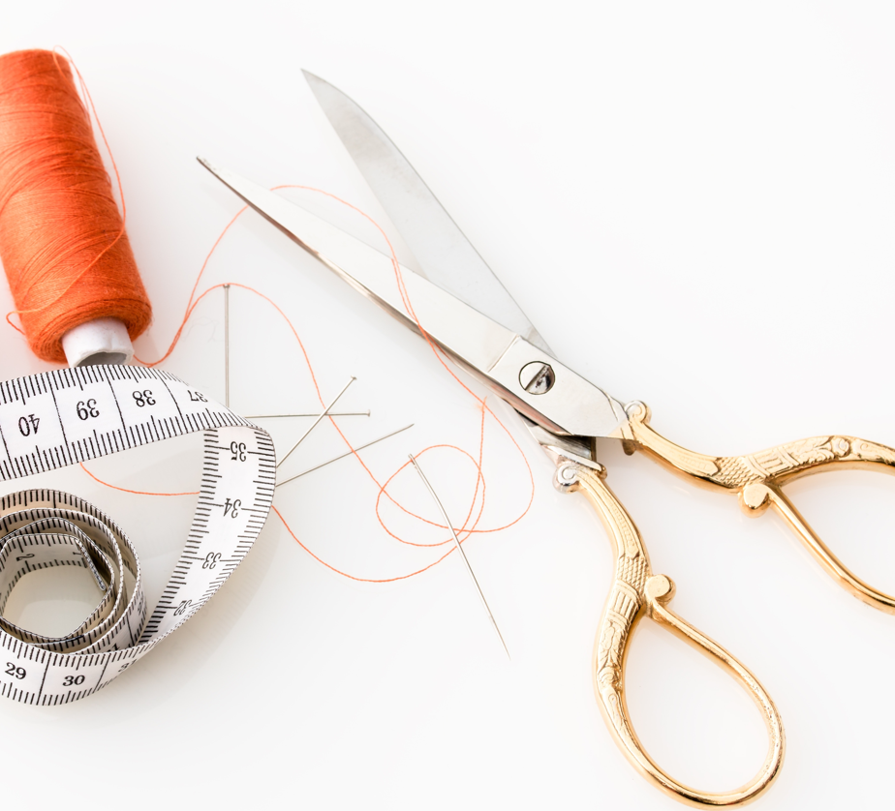
Course Fees and Associated Costs (approximate)
Classroom materials fee: $100
You will also need to source:
Stationery supplies, folders etc
Basic sewing kit
Patternmaking rulers
Scissors for cutting fabrics
Scissors for cutting card and paper
Access to a computer and internet
Desirable Books –
Patternmaking for Fashion Design (Helen Armstrong),
The Fashion Design Manual 2 (Pamela Stecker)
Fabrics for garments
And other items listed on the 2023 Supply List
Notes:
There are a number of associated costs in addition to the course enrolment fee. The $100.00 materials fee contributes towards class supplies such as machinist training samples, patternmaking paper, art supplies, calico for toiles, threads, garment notions etc.
Students are also responsible for a number of other items including all stationary and folder supplies, sewing kits, Pattern making rulers, scissors (both fabric and paper), access to a computer and internet, and fabric for final garments.
These are just some of the items you will need. A 2023 supply list will be available online which outlines all requirements which students must have. Students are encouraged to purchase key text books as they are a valuable resource to have accessible.
Copies are available at TasTAFE libraries however loan times may be limited.
https://www.pexels.com/photo/fabric-scissors-needle-needles-scissors-461035/

Slide 15
Course Fees and Associated Costs
Desirable off campus equipment
In order to practice your skills it is desirable for you to have access to the following items outside of TAFE:
A sewing machine
An iron
An ironing board
A large table
Laptop or computer
Notes:
Whilst students are at TasTAFE they have access to a variety of equipment and machinery, however if you need to complete work outside of TAFE or catch up on missed work it is desirable that you have access to a sewing machine, iron and large table for patternmaking.

Slide 16
Employment Opportunities
Sewing machinist
Assistant patternmaker
Fashion design assistant
Clothing Alterations & Repair
Fabric/Haberdashery or Fashion Retail
Notes:
Our graduates are employed in a number of areas within the fashion industry. The skills developed in Certificate III assist students to gain employment as a sewing machinist, assistant patternmaker, fashion design assistant,
basic clothing alternations and fabric, haberdashery or fashion retail.

Slide 17
Further Study
Certificate IV or Diploma Fashion Design Qualifications
Bachelor Degree Studies in Fashion
Business Qualifications
Notes:
On completion of the Certificate III in Applied Fashion Design & Technology students may wish to seek employment or pursue further study in higher level Fashion qualifications, or diversify into business qualifications if they are aiming to become self employed.

Slide 18
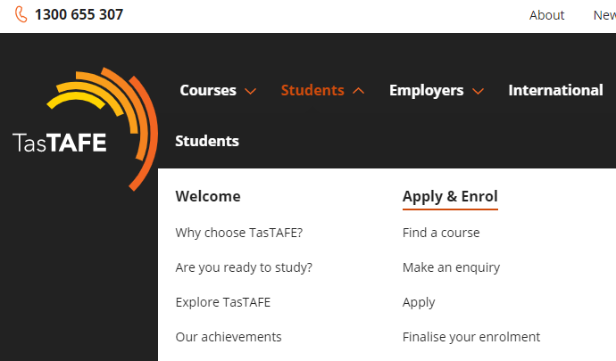
The Application Process
Applications will open on Tuesday 8th November 2022, 12pm midday.
Visit our website and go to the apply & enrol page and watch our Applying at TasTAFE presentation.
After you have submitted your application keep an eye on your emails as we will advise the outcome of your application or if we need further information from you.
Notes:
The application process to apply for Certificate III will be open on the 8th of November. Visit the TasTAFE website and go to the “apply & enrol” page and watch the “Applying at TasTAFE presentation” for instructions.
Once you have applied, keep an eye on your emails for further advice around your application.

Slide 19
Student Support
If you need assistance or support during your time at TasTAFE, please don’t hesitate to contact one of Student Counsellors or Disability Liaison Officers for help.
We offer a range of student services including:
support with additional literacy and numeracy
study skills
advice about financial assistance
counselling
disability support
career planning
Call 1300 655 307 to make an appointment or visit the student support section on our website.
Notes:
TasTAFE offers assistance and support to enrolled students. Friendly student councillors and disability liaison officers are ready to help with your individual needs.
There are a variety of ways assistance can be provided from literacy, numeracy and study skill support to financial assistance advice, counselling, disability support and career planning.
Support can be accessed by phoning 1300 655 307 or visiting the TasTafe website, student support section.

Slide 20
Thank you for your interest!
If you have more questions send them to:
creativeindustries@tastafe.tas.edu.au
Please view the Frequently Asked Questions

Slide 21
Frequently Asked Questions – Studying Applied Fashion Design
Will there be an interview process?
No.
What basic equipment do I need and should I purchase the equipment before the course starts? Or wait for the first lesson?
A basic supply list will be available on the website. You do not need to purchase all of the items on the supply list if you are unfamiliar with them. Please bring a basic sewing kit to class in the first week – this will include scissors, pins, measuring tape and unpicker/seam ripper, as well as a few pens, pencils and a notebook. Your teacher will be able to go through the supply list with you before you purchase other items.
Do I need access to any special equipment outside of TAFE?
It is desirable that you have access to a sewing machine, ironing board and iron and large table so that you can complete homework. If you do not have this equipment you may be able to borrow items from friends or family members during the course.

Slide 22
Do I need to purchase my own fabrics?
We do have fabric in our workrooms for testing patterns and sample garments, however if you prefer your own choice of fabric in Certificate III, then you can purchase your own. Staff will communicate to students when this is an option.
Do I need a laptop or computer?
It is highly desirable to have a laptop or computer available at home. If you do not, you will need to access the TasTAFE library regularly to complete homework and make arrangements to join in on online sessions. You are able to access TasTAFE laptops during on campus, class training.
Do I need any special software programs?
When you are enrolled at TasTAFE you will have access to the Office 365 suite of programs and access to our online learning platform, CANVAS. You will be equipped with the necessary programs which interface with the online learning platform. If you bring skills and knowledge of other software programs, you can integrate these skills within the project work.
Can I get funding to purchase equipment for home?
If you are experiencing financial hardship, please make an appointment to speak with a TasTAFE student counsellor by visiting https://www.tastafe.tas.edu.au/connect or calling 1300 655 307. Alternatively ask for assistance at a TasTAFE Client Service desk on campus.

